Slide 1

Chicago Traffic Crashes Analysis
Presented by Group 7:
Bo Gu
Fan Yang
Jianghong Man
Yanbo Sun

Slide 2
Contents
Data Engineering Tools
Business Use Case
Data Visualization
Lessons Learned
Executive Summary
Data Profile
Design Considerations
Recommendations

Slide 3
452,050 traffic accidents in Chicago
From September 2017 to present

Slide 4
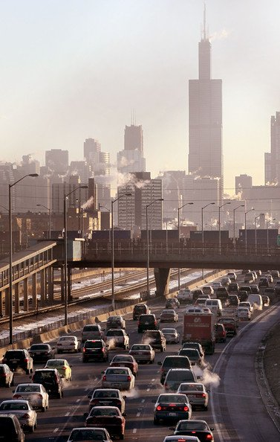
Executive Summary
In Chicago, the annual number of car crashes is around 150,000 in the past three years, around 200 of which involve at least one fatality. These statistics together paints a bleak picture of Chicago roadways.
By extracting, analyzing the crashes data for the past three year in Chicago, including time, location, injury condition and car type, etc., we aim to support decision-making processes for several parties regarding to the information and knowledge obtained from the data.
The functionality of the tool includes ETL process of raw data, storage and access data from relational databases, cleansing, analysis and visualization of data.

Slide 5




Business Use Case
Use Case Persona | Business Use | Data Utilized
Insurance Companies | Adjust policy premiums based on the crash statistics to maximum profit | Personal and vehicle information in car crashes
Government | Establish precautions and guidance around accident-prone zones, including speed limits, stop signs, traffic lights etc. | Geographic features of crashes Timing and weather data of crashes Causes of crashes
Navigation Service Providers | Provide notification for drivers when risks of accidents are high, e.g. accident-prone zones, adverse weather conditions etc. | Geographic features of crashes Timing and weather data of crashes
DMV & Police Department | Enhance law enforcements to contain risky driving behaviors | Causes of crashes

Slide 6
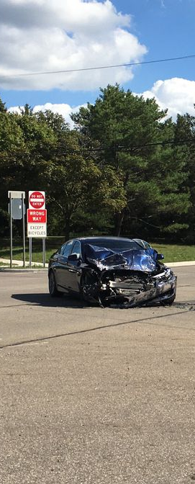



Data Sources
Traffic Crashes – Crashes:
Crash data shows information about each traffic crash on city streets within the City of Chicago
Traffic Crashes – People:
A dataset of people related to these crashes
Traffic Crashes – Vehicles:
A dataset of vehicles related to these crashes

Slide 7

Data Profile
Data Size:
Traffic_Crashes_-_Vehicles.csv 304.5 MB
Traffic_Crashes_-_People.csv 321 MB
Traffic_Crashes_-_Crashes.csv 268.5 MB
Dataset Overview:
Vehicles: 937K Rows, 72 Columns, Each row is a Vehicle
People: 1.02M Rows, 30 Columns, Each row is a Person
Crashes: 459K Rows, 49 Columns, Each row is a Crash
3 dataset joined on ‘Crash_Record_ID’
Types of Data Used
All data collected are structured data.

Slide 8
Data Profile
Data Quality Metrics
Completeness | Overall, the data acquired from the City of Chicago is complete based on the attribute level. It provides crash, people, and vehicle information for each accident, connected by crash record id. One little defect of the dataset is that it does not provide the community of each crash. We have to manually classify each street to a specific community for analysis.
Accuracy | cityofchicago.org is a reliable source. Some datasets are updated at least once a day, while others are updated multiple times a day. Thus, we can trust the data collected.
Consistency | Three tables (crash, people, and vehicle) are joined on crash record id, which is a unique identifier representing each crash happened in Chicago. Thus, each crash can be tracked by specific attributes.
Validity | Every record of data conforms to required value attributes. For instance, each crash date conforms to the same format in the crash table. Overall, the data is organized and easy to use.
Timeliness | From the analysis of Tableau, we can see that the amount of data before 2016 and after 2016 varies much. We can assume that the government system was not relatively complete and mature then so that it did not track as much data as recent years. Hence, in order to analyze the most accurate scenario of car crash, we ought to filter the data to after 2016 to achieve better result.
Uniqueness | In the three data sources, each row represents single car, person, or crash information. They have unique ids to separate from each other. Thus, the data fulfills the uniqueness criteria.

Slide 9











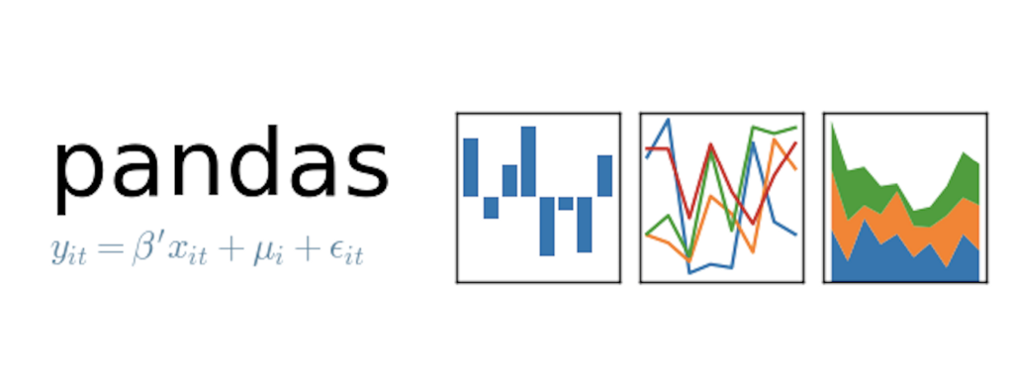
Data Engineering Tools
Raw Data & Database
Data Analytics
Visualizations

Slide 10
Design Considerations and Data Modeling

Slide 11
Design Consideration and Data Modeling
Build a relational model using MySQL Workbench stored GCP
The data were imported to the database through GCP
Transform the relational model into a dimensional model through configuring the tables and relationships in the original relational model
We decided to build our project on a dimensional model due to the following reasons:
More understandable
Group information into coherent dimensions related to car crashes
Simpler to create analytical queries
Scalable and easily accommodate unexpected new data

Slide 12
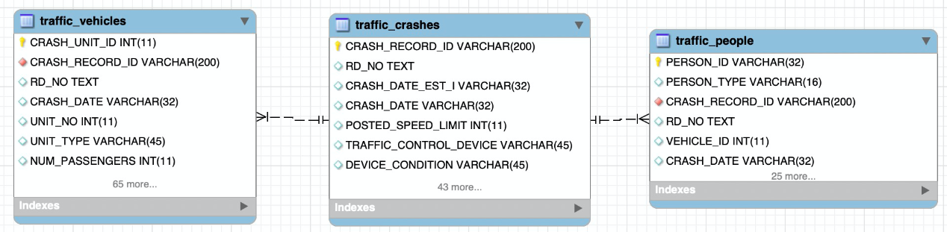
Relational Model ER
The Relational Model EER shown above reflects the connections between 3 data sources taken into our project: crashes information, vehicle and people information linked to the crashes. The tables are then split into sub-tables to construct a Dimensional Model.

Slide 13
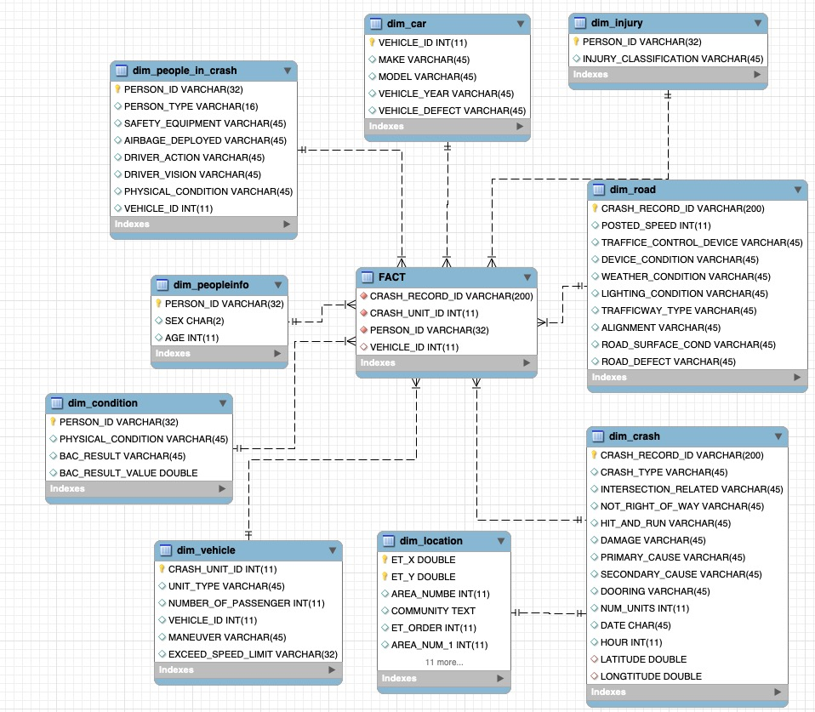
Dimensional Model

Slide 14
NOSQL Database

Slide 15
Data Lake
Database and all the raw data are loaded to Google Cloud Platform (GCP) to create online centralized data storage as well as provide teammates and end users with easier access to data.
Address: 35.226.111.65
GCP also facilitates data analysis and visualization as Tableau and MySQL Workbench can directly connect to GCP.

Slide 16
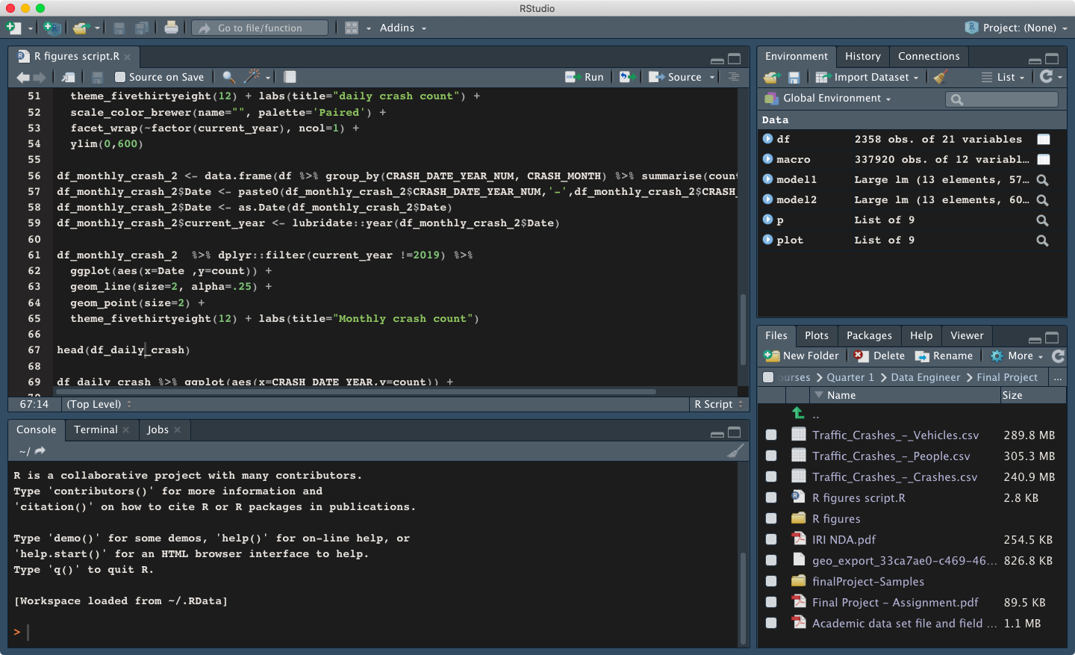
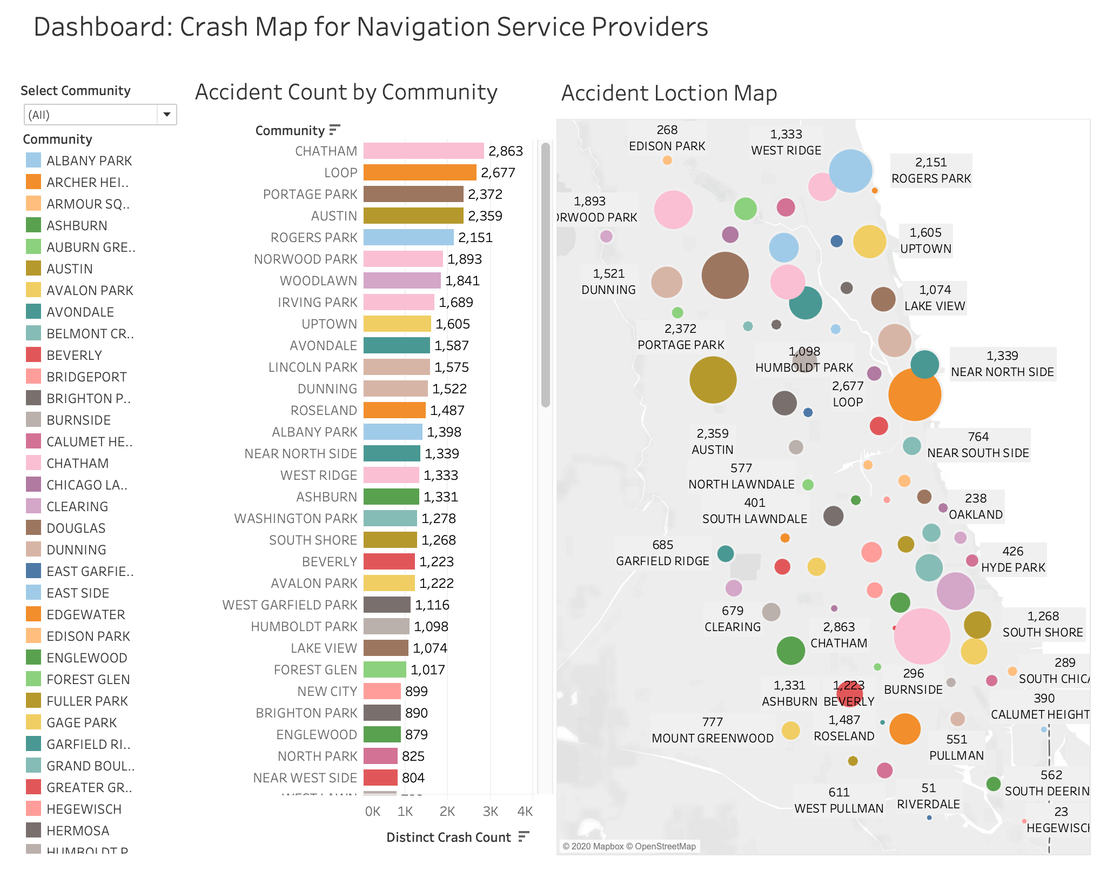
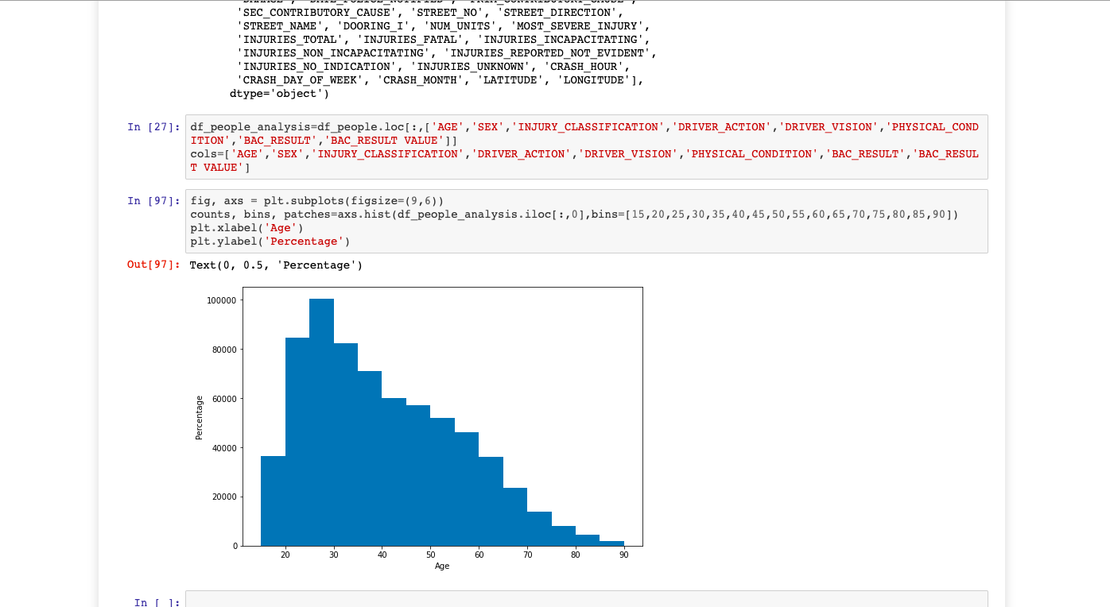
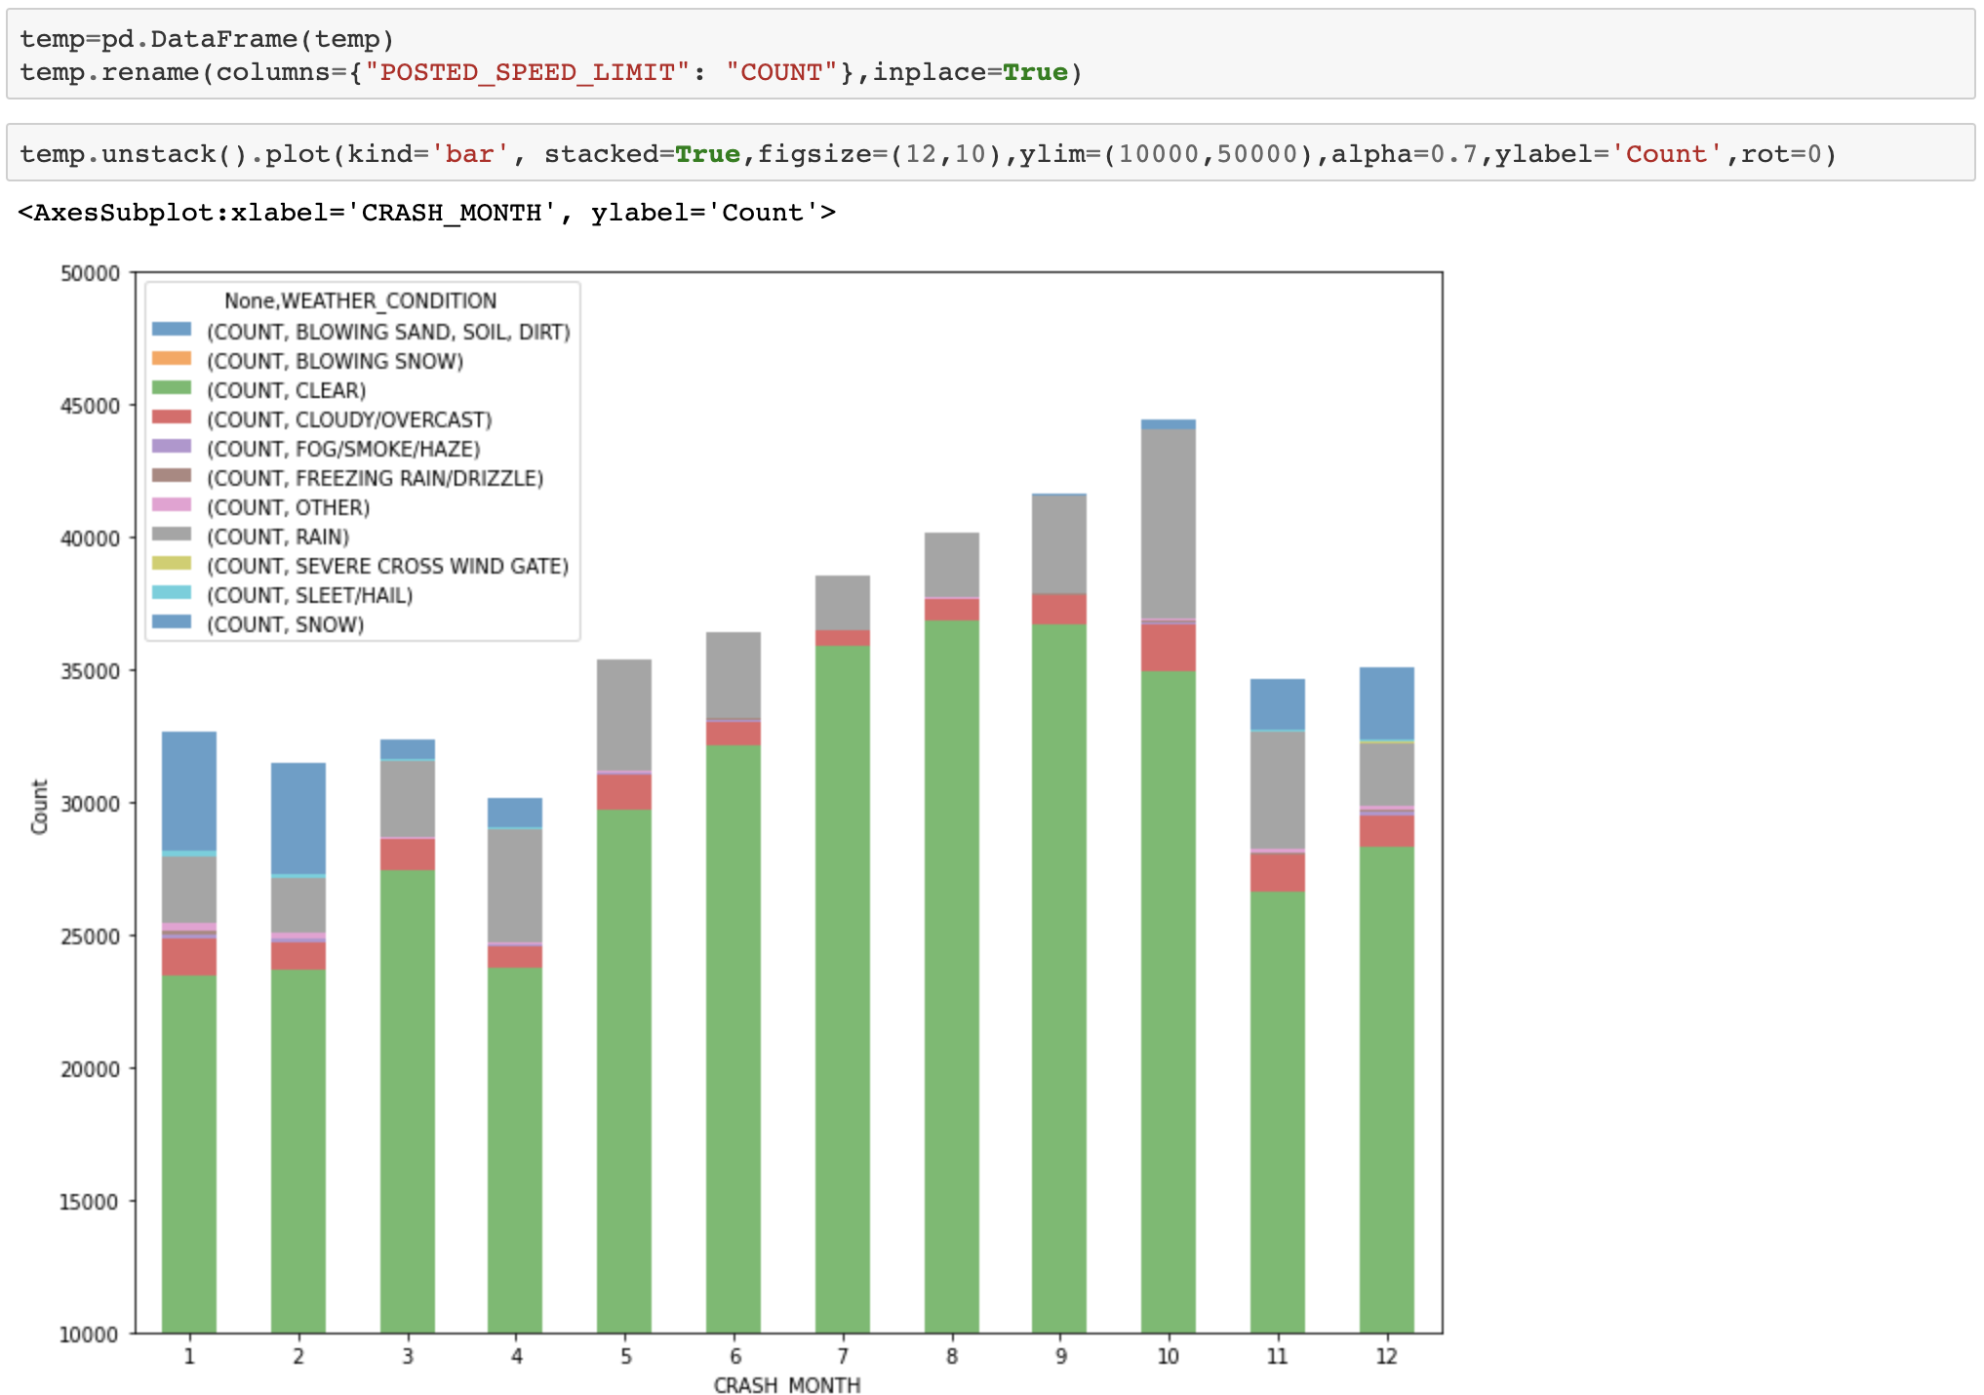
R Reports
Tableau Reports
EDA from Python
Data Visualization

Slide 17
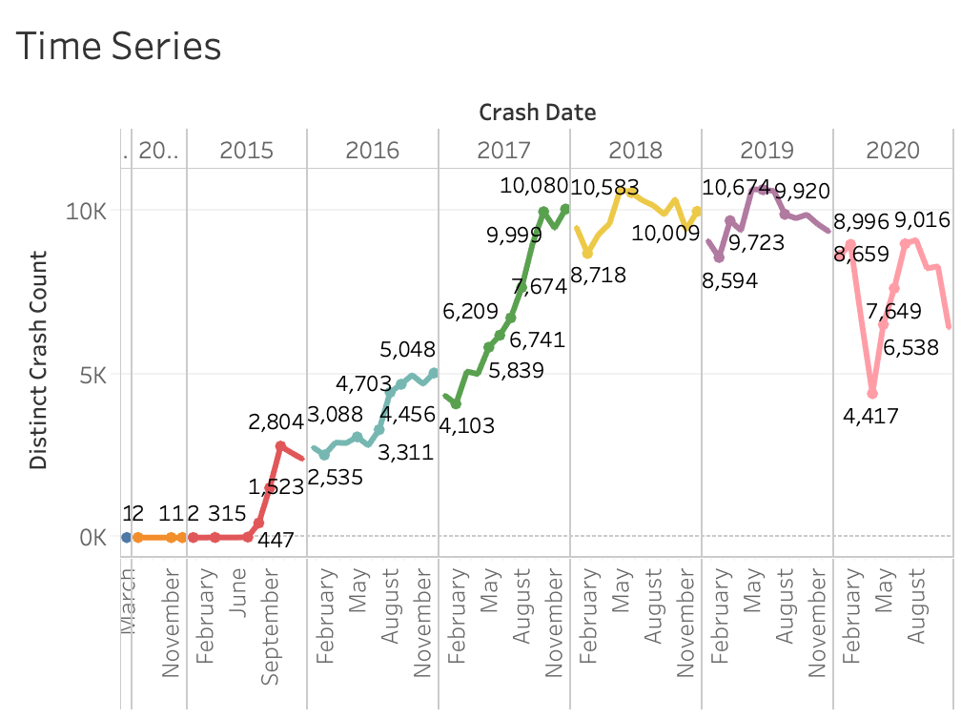
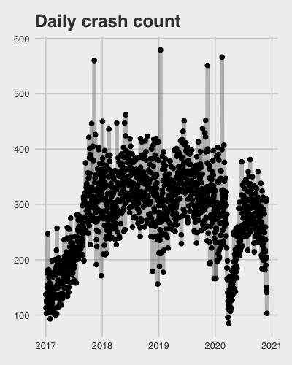
Time Series of Car Crashes

Slide 18
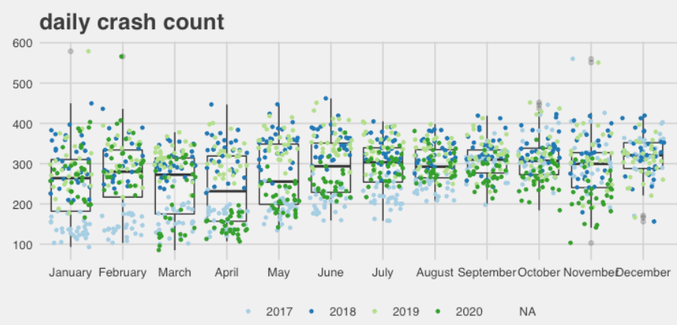
Monthly & Daily Crashes

Slide 19
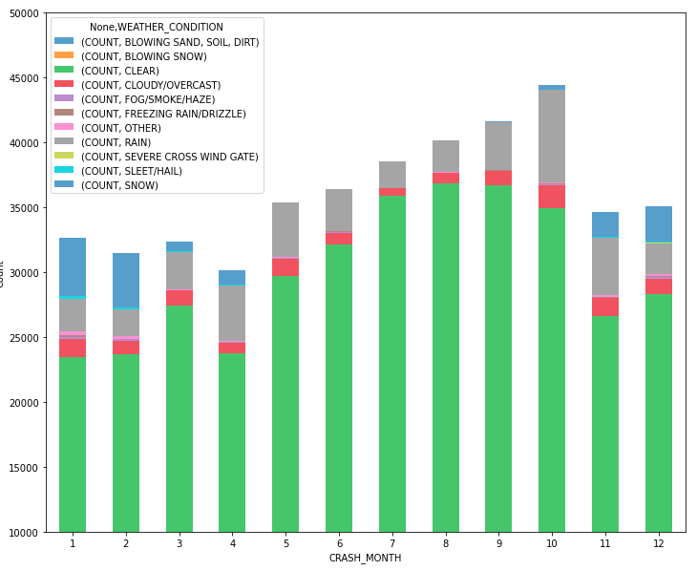
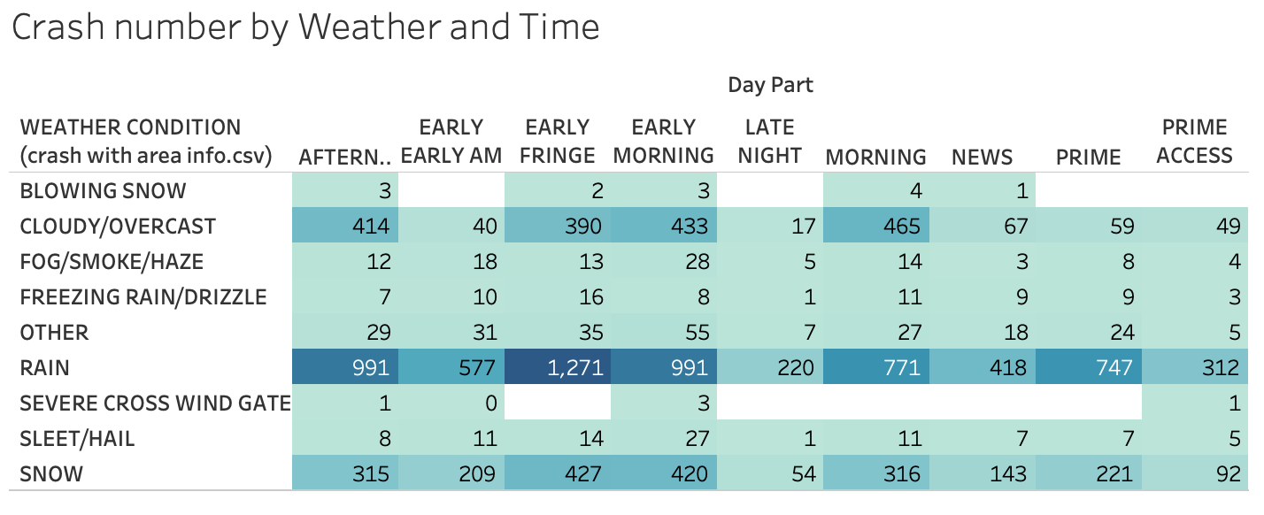
Weather Effect to Car Crashes

Slide 20
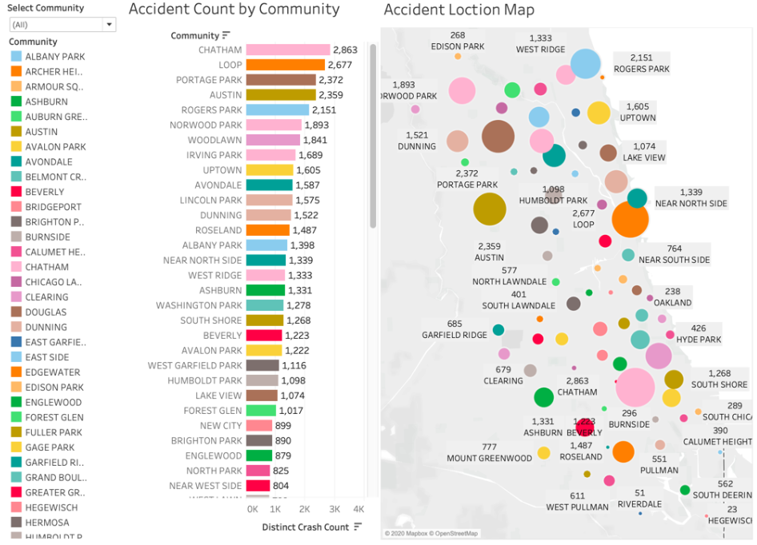
Popular locations of Car Crash

Slide 21
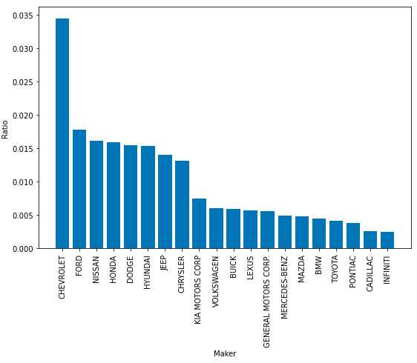
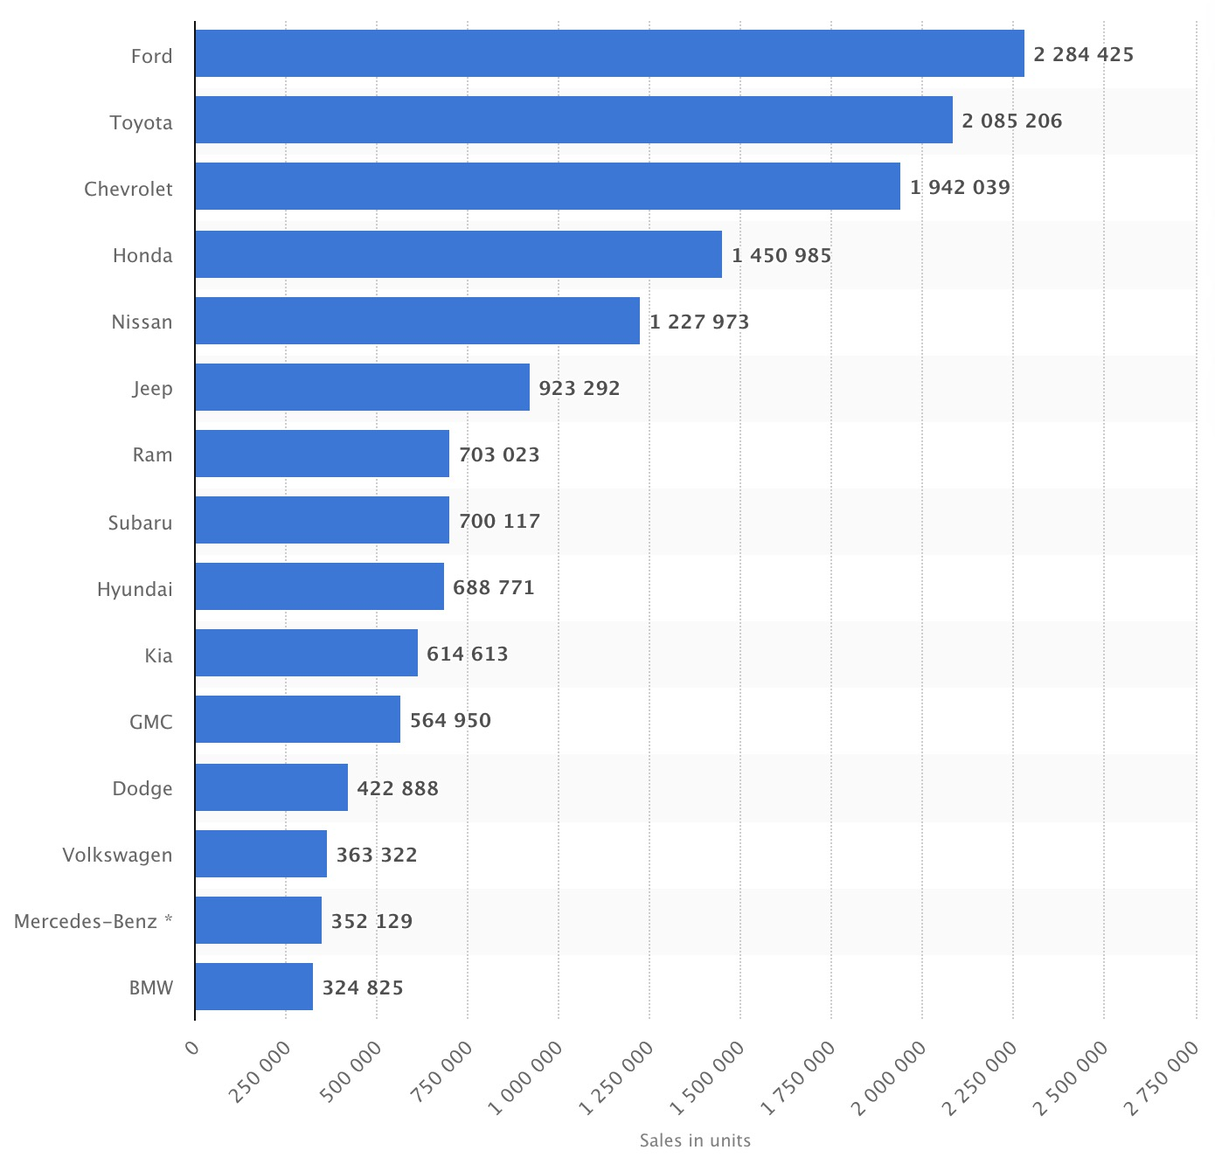
Car Makers & Crashes
Percentage of car maker in car accident
Car sold in the U.S in 2019 by makers

Slide 22
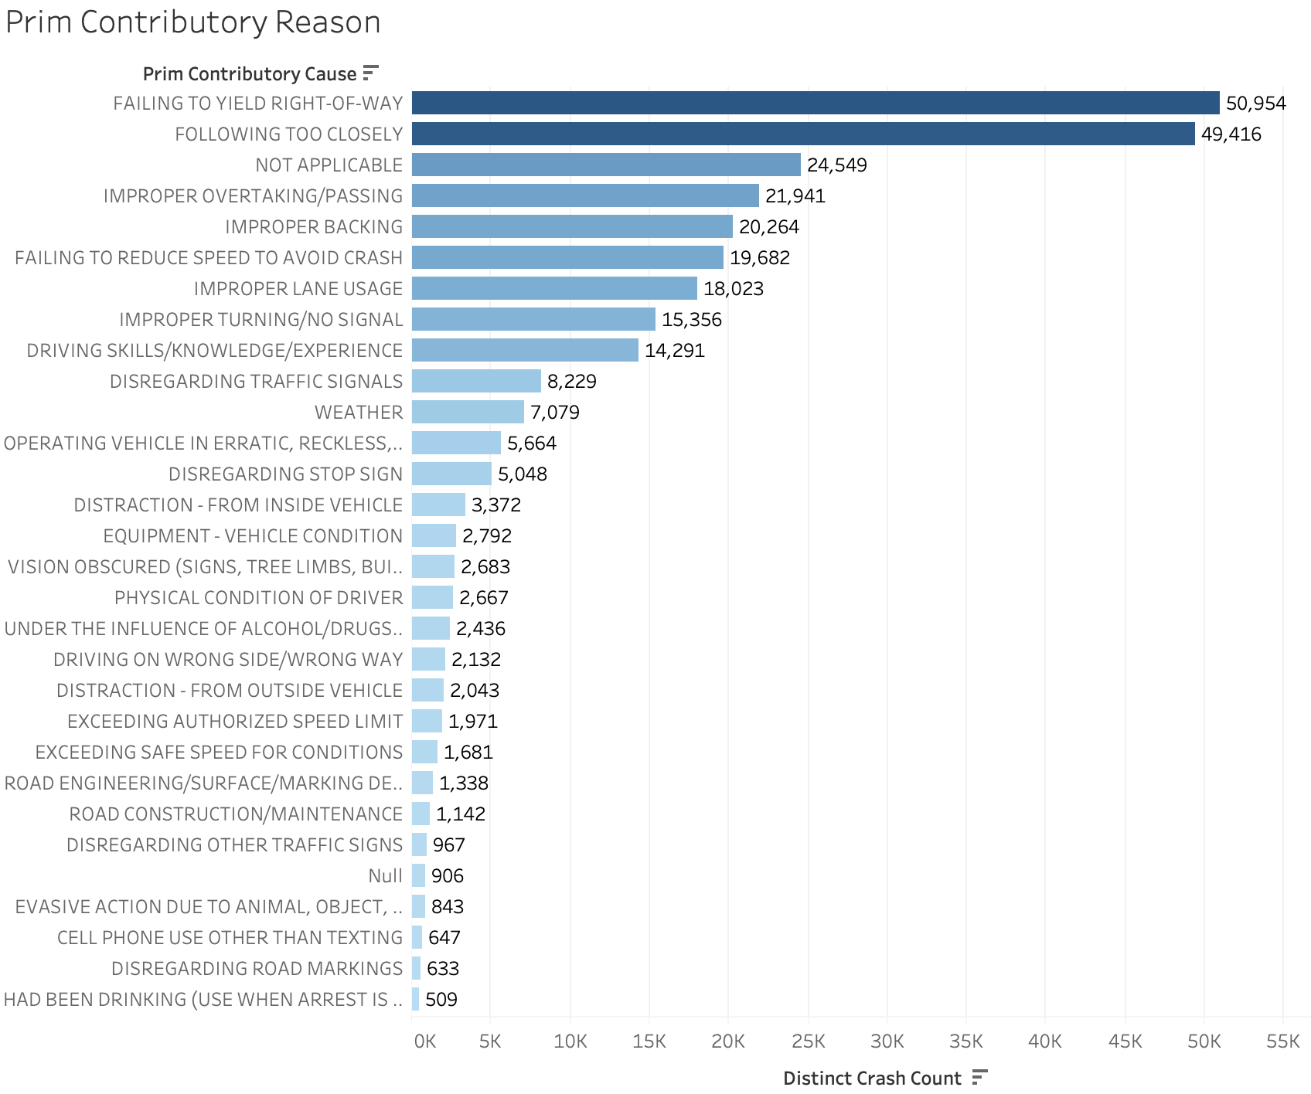
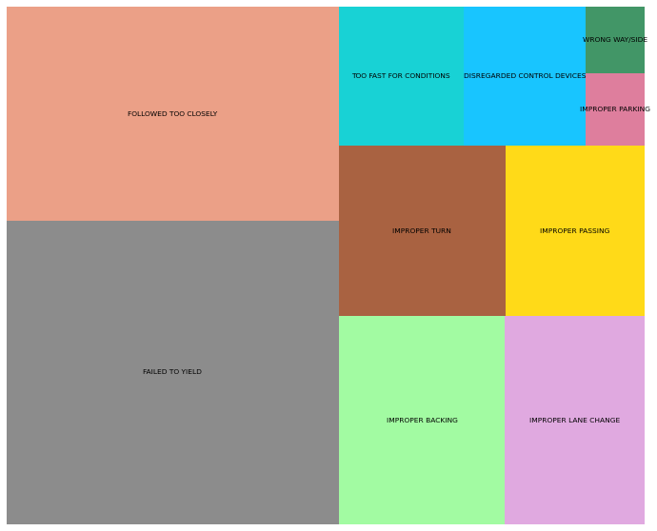
Cause of Crashes

Slide 23
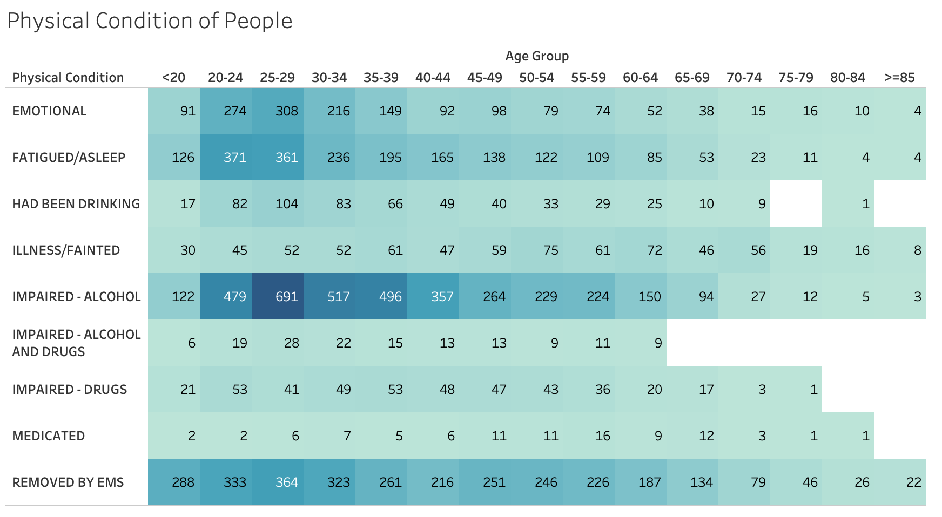
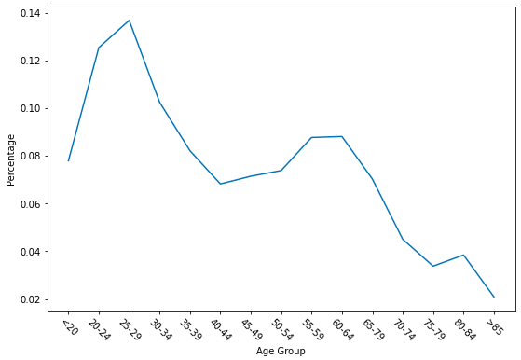
Age Group & Physical Condition in Crashes
Percentage of licensed driver involved in a crash within different age group

Slide 24

Recommendations for Business Use Cases

Slide 25
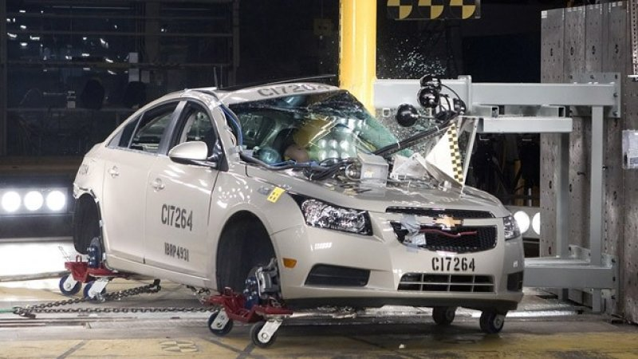
Insurance Companies
Increase policy premiums for risky age groups
20 – 39, 55 – 64
Increase policy premiums for risky car models
Chevrolet, Ford, Nissan, Honda, Dodge
Slightly increase cash reserves during the 2nd half of years
There are more car crashes in the latter half of years

Slide 26

Government
Establish precautions and guidance around accident-prone zones, including speed limits, stop signs, traffic lights etc.
Communities with most accidents: CHATHAM, LOOP, PORTAGE PARK, AUSTIN, ROGERS PARK etc.

Slide 27
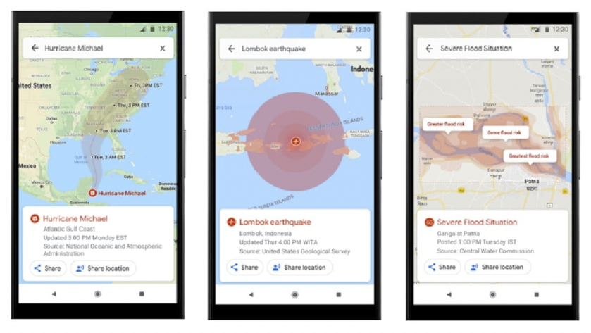
Navigation Service Providers
Provide notifications to users when passing risky regions
Communities with most accidents: CHATHAM, LOOP, PORTAGE PARK, AUSTIN, ROGERS PARK etc.
Provide notifications to users when there are adverse weather conditions.
Snow, Rain, Cloudy, Fog/Smoke/Haze

Slide 28

DMV & Police Department
Enhance related inspection in driving tests
Top causes of crashes: Failed to yield, Followed too closely, Improper lane change, Improper passing, Improper backing, Too fast for conditions
Enhance law enforcements to contain risky driving behaviors

Slide 29
Lessons Learned
It would be much more efficient to load data directly from CSV files on GCP compared to importing wizards in MySQL Workbench.
Data should be examined before cleansing.
It is difficult to gain useful information by visualizing millions of records on the map and we need to group it by different communities or regions.
Same information can be visualized in multiple ways and we should choose the method that people can appreciate it easier.
We should keep in mind that all considerations regarding to database designs and visualizations should serve for the decision-making process of our business problems.

Slide 30




Team Profile
Bo Gu
Data Analyst
WeLoveShree Inc.
BA, University of California Irvine
MScA, University of Chicago
Fan Yang
Data Engineer
WeLoveShree Inc.
B.Eng, Nanyang Technological University
MScA, University of Chicago
Jianghong Man
Data Visualization Specialist
WeLoveShree Inc.
BA, Boston University
MScA, University of Chicago
Yanbo Sun
Data Scientist
WeLoveShree Inc.
BAcc, Singapore Management University
MScA, University of Chicago

Slide 31
Thank you!
Q&A

Slide 32
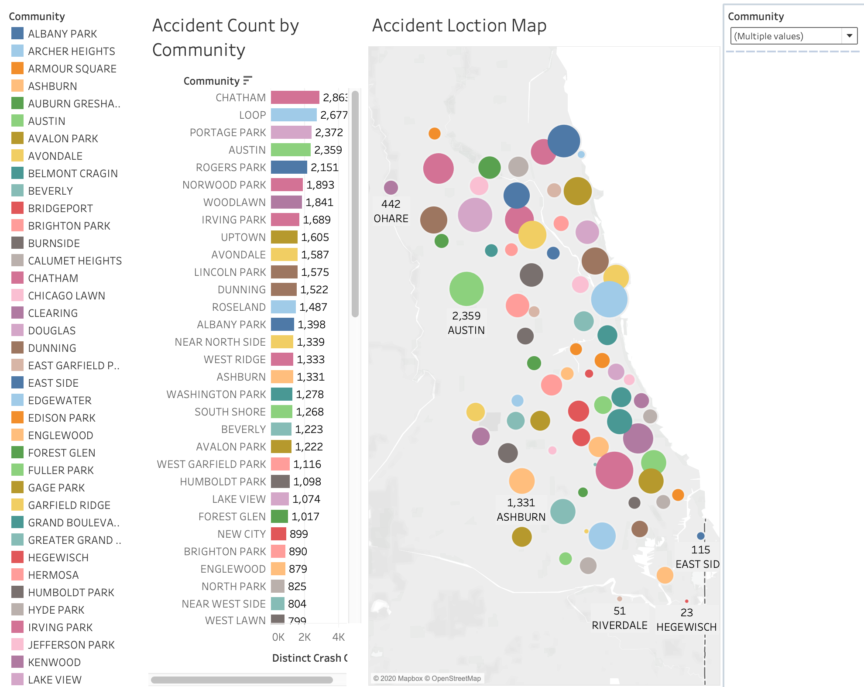
Appendix 1: Tableau Dashboard 1

Slide 33
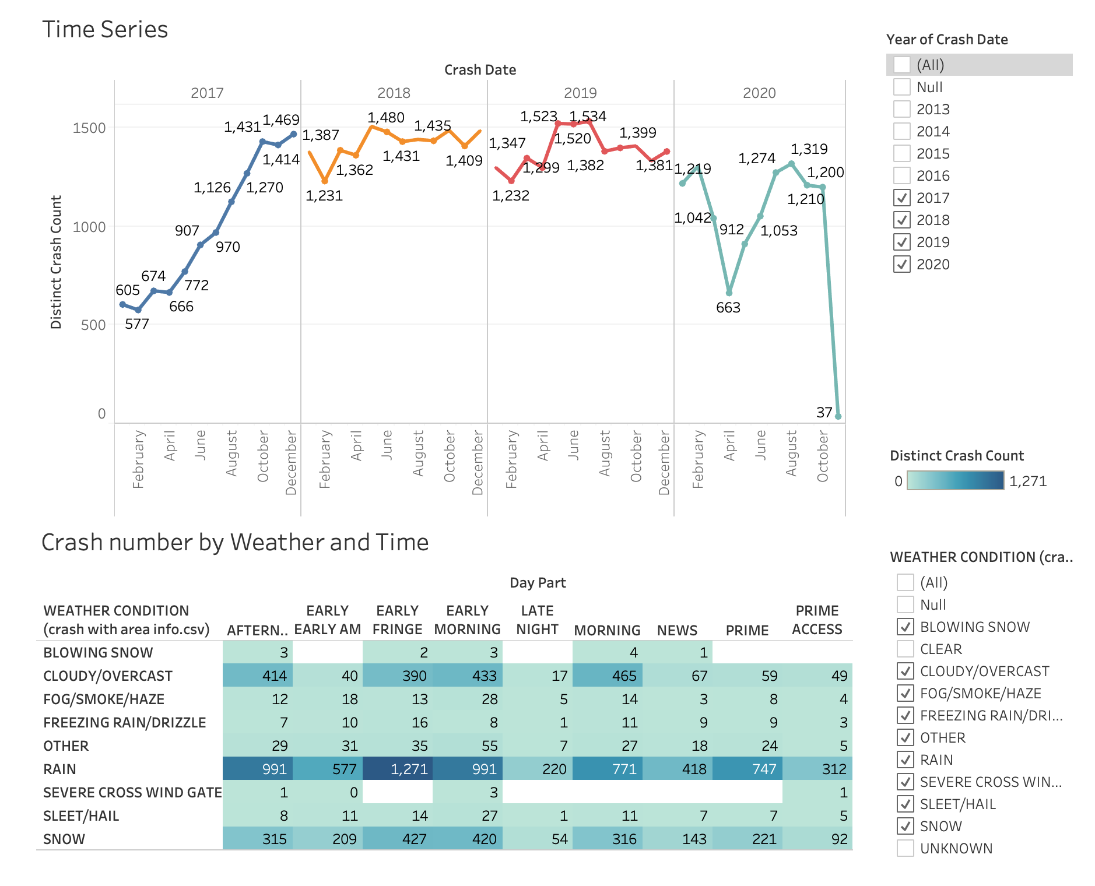
Appendix 2: Tableau Dashboard 2

Slide 34
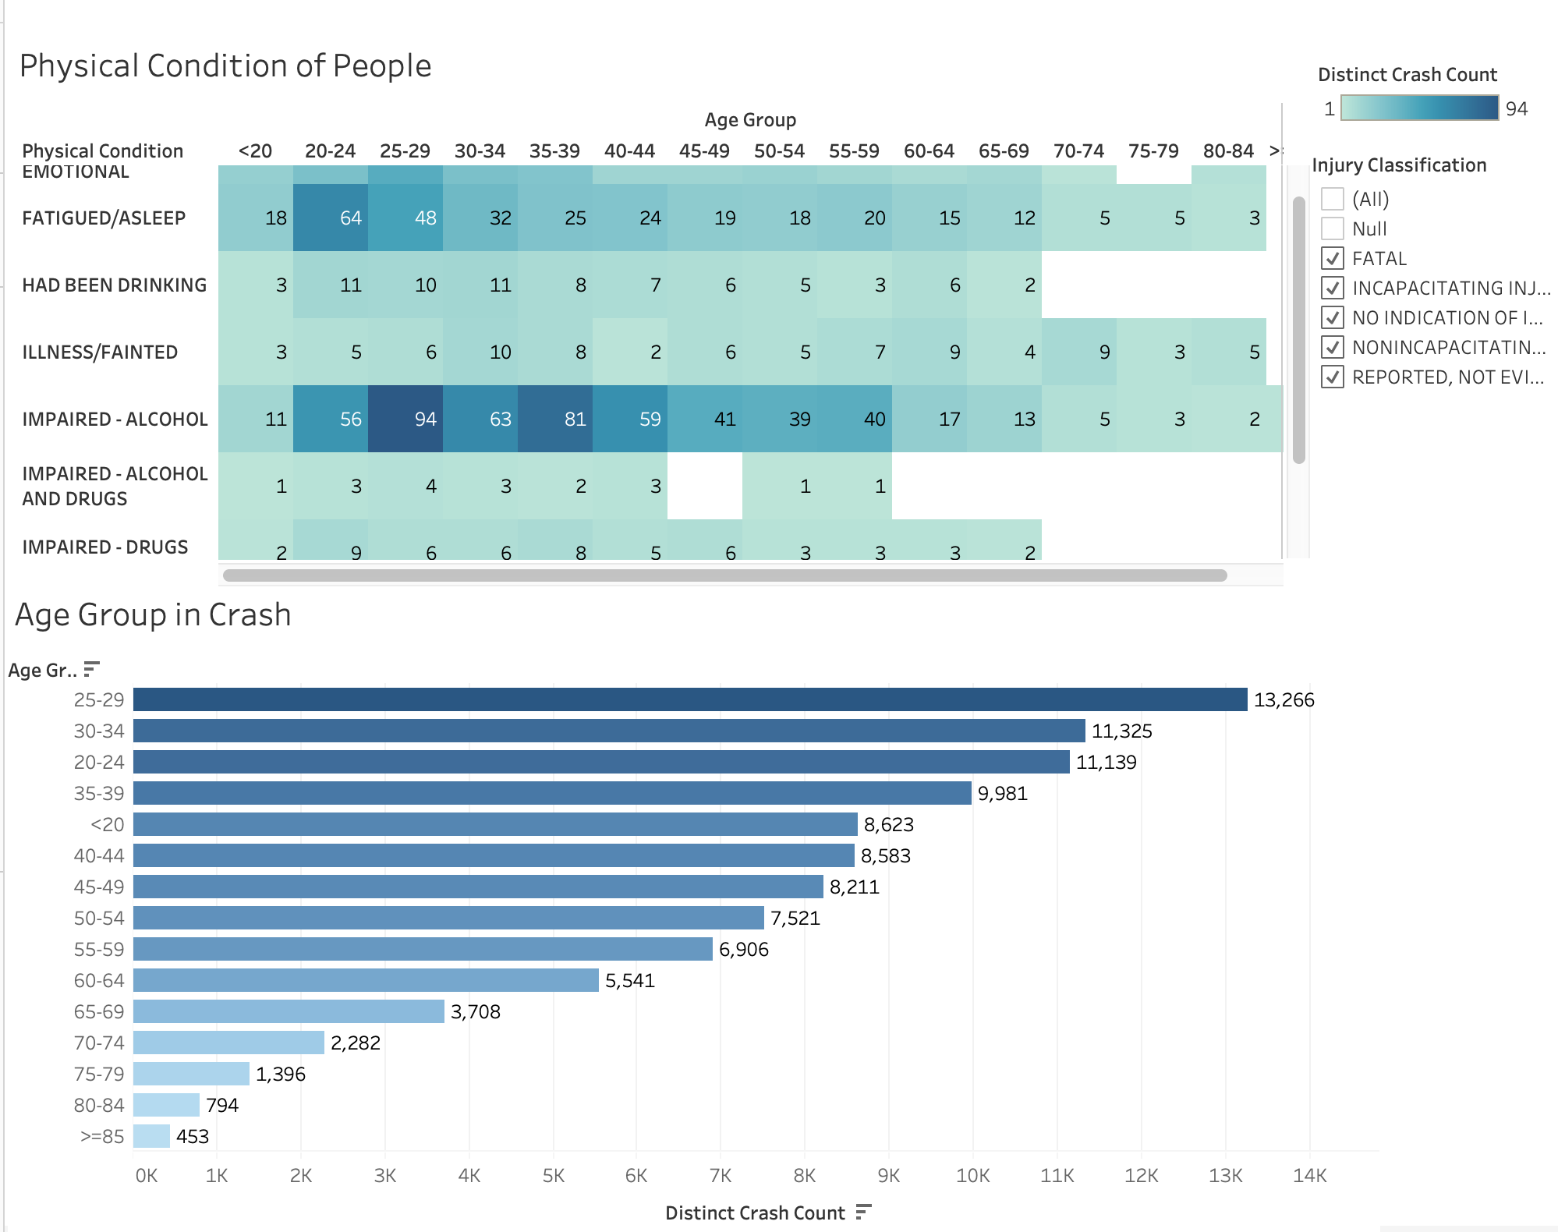
Appendix 3: Tableau Dashboard 3

Slide 35
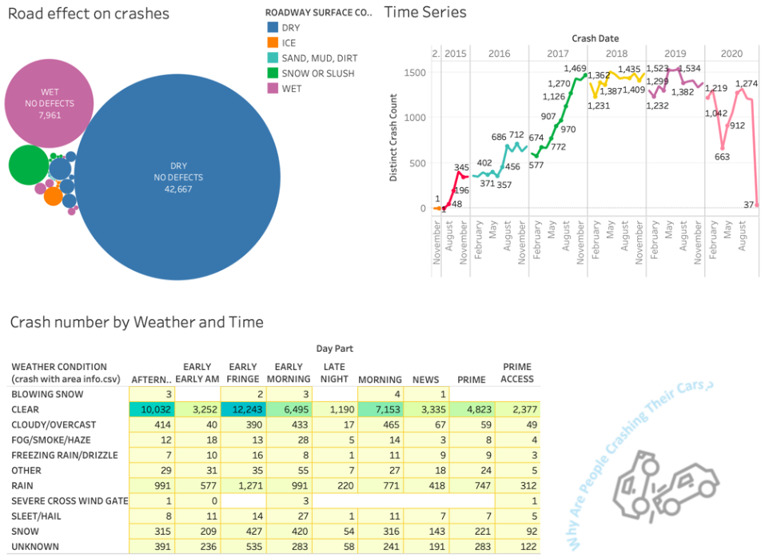
Appendix 4: Tableau Dashboard 4

